Slide 1


COZY CAFFE

Slide 2
Dashboard Project
Presented by : ruchita goti
Tisha BHIMANI
AGENDA :
Overview of Company
To know about Data and problems of Company
Power Query Editor
Pivot Table
Dashboard

Slide 3

Company overview
Company established since from 2000.
Company mainly produce some food product categories like :
Bakery products,
Branded,
Coffee,
Coffee beans,
Drinking Chocolate,
Flavours,
loose Tea,
Packaged chocolate,
Tea.
Company’s main 3 branches store like :
Astoria,
Hell’s kitchen,
Lower Manhanttan.
Company’s growth going good but company some problems faces so that our client want to solve this problem.

Slide 4

TO KNOW ABOUT DATA & PROBLEMS OF
COMPANY

Slide 5
Data available in so many ways like .xls, .csv and so on.
Our data is available in Company.csv file.
Company wants to analyse :
1. Quantity Ordered & revenue generated in based on Hour
2. Footfall over Product category
3. High generated Product sales in particular date.
4. Top 5 Products based On Sales
5. Bottom 5 Products based On Sales
6. Chart Footfall & sales over various store Location.

Slide 6

Power query Editor

Slide 7
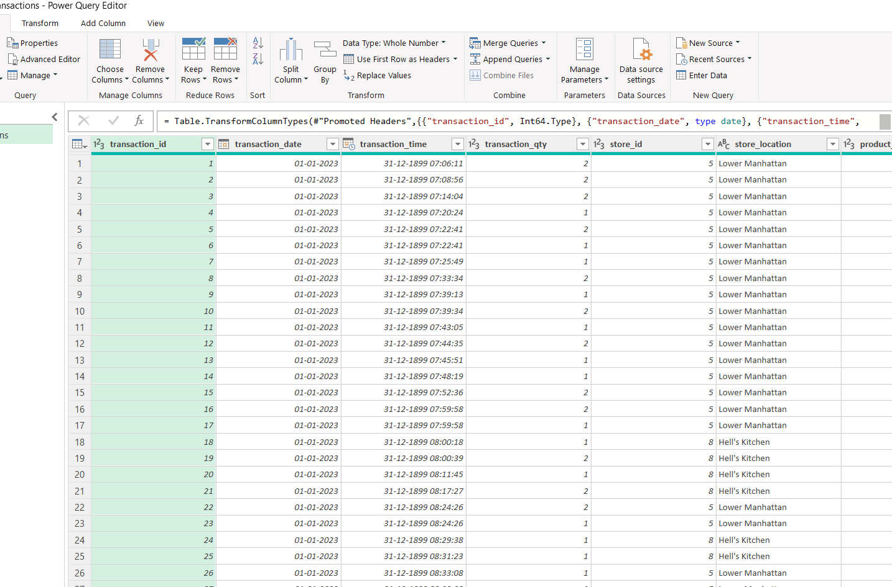
Importing Data

Slide 8
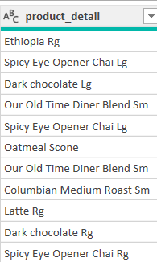
Conditional column
Rg
Lg
Sm

Slide 9
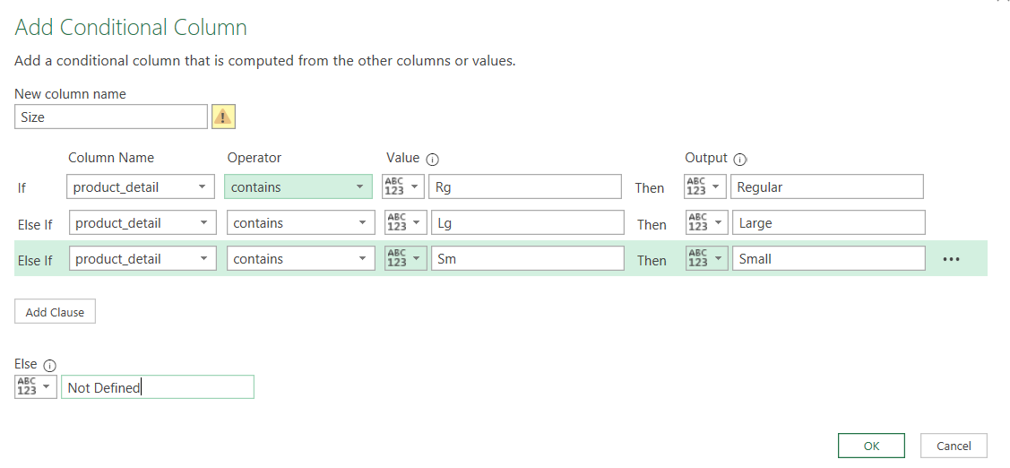
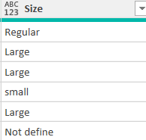
Replaced Value
Transform tab
Replace value
Lg Large
Rg Regular
Sm Small

Slide 10
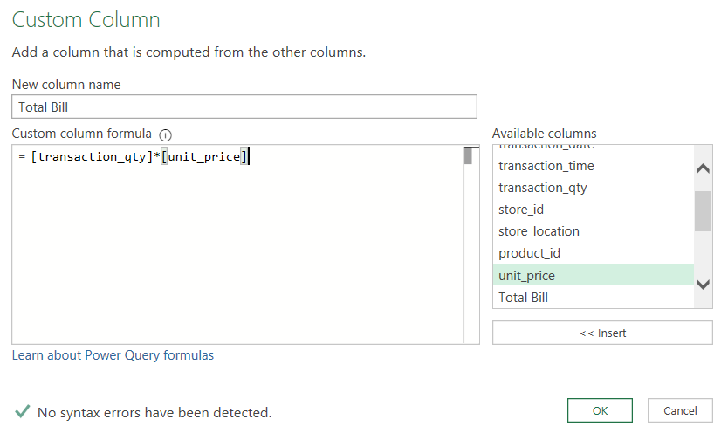
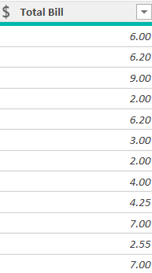
Add custom Column
“ Total Bills “
Quantity * Unit Price

Slide 11
Extract Transaction Time
“Transform Tab”
“Extract “
“Tax After Delimiter”

Slide 12
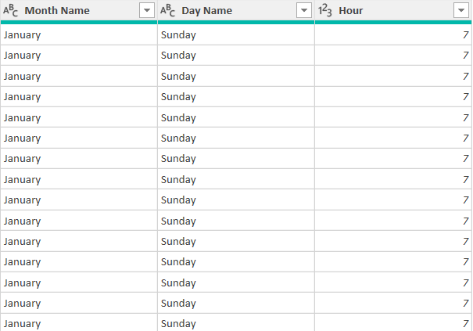
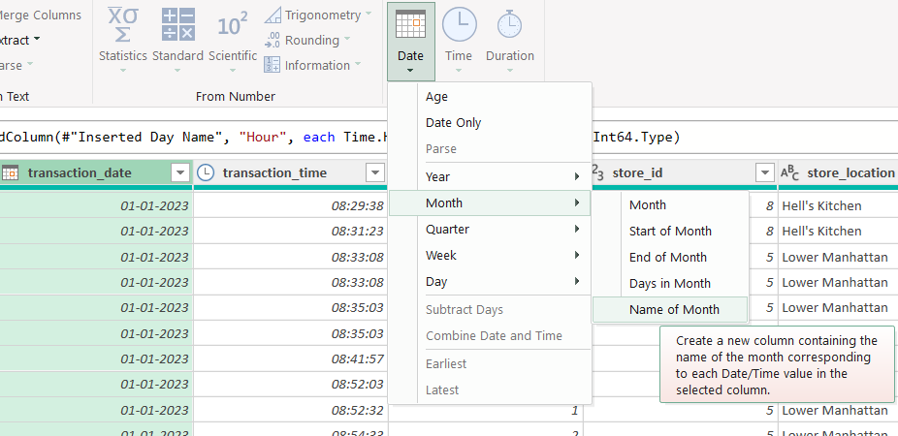
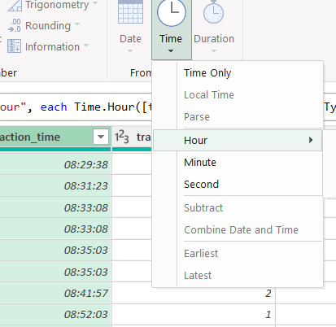
INSERT
INSERT
ADD COLUMN
DATE
MONTH
NAME OF MONTH
ADD COLUMN
DATE
TIME
HOUR
INSERT
ADD COLUMN
DATE
DAY
NAME OF DAY

Slide 13

PIVOT TABLE

Slide 14
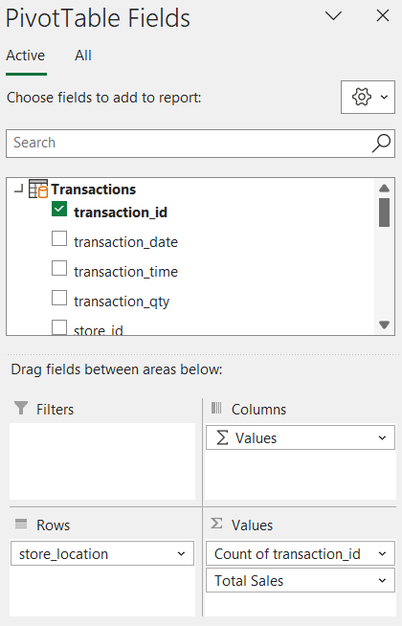
Create Pivot table
1. Select the data range and go to the insert tab then click on pivot table.
2. Drag & Drop Field into the rows, column, value & filter area to organise data.

Slide 15
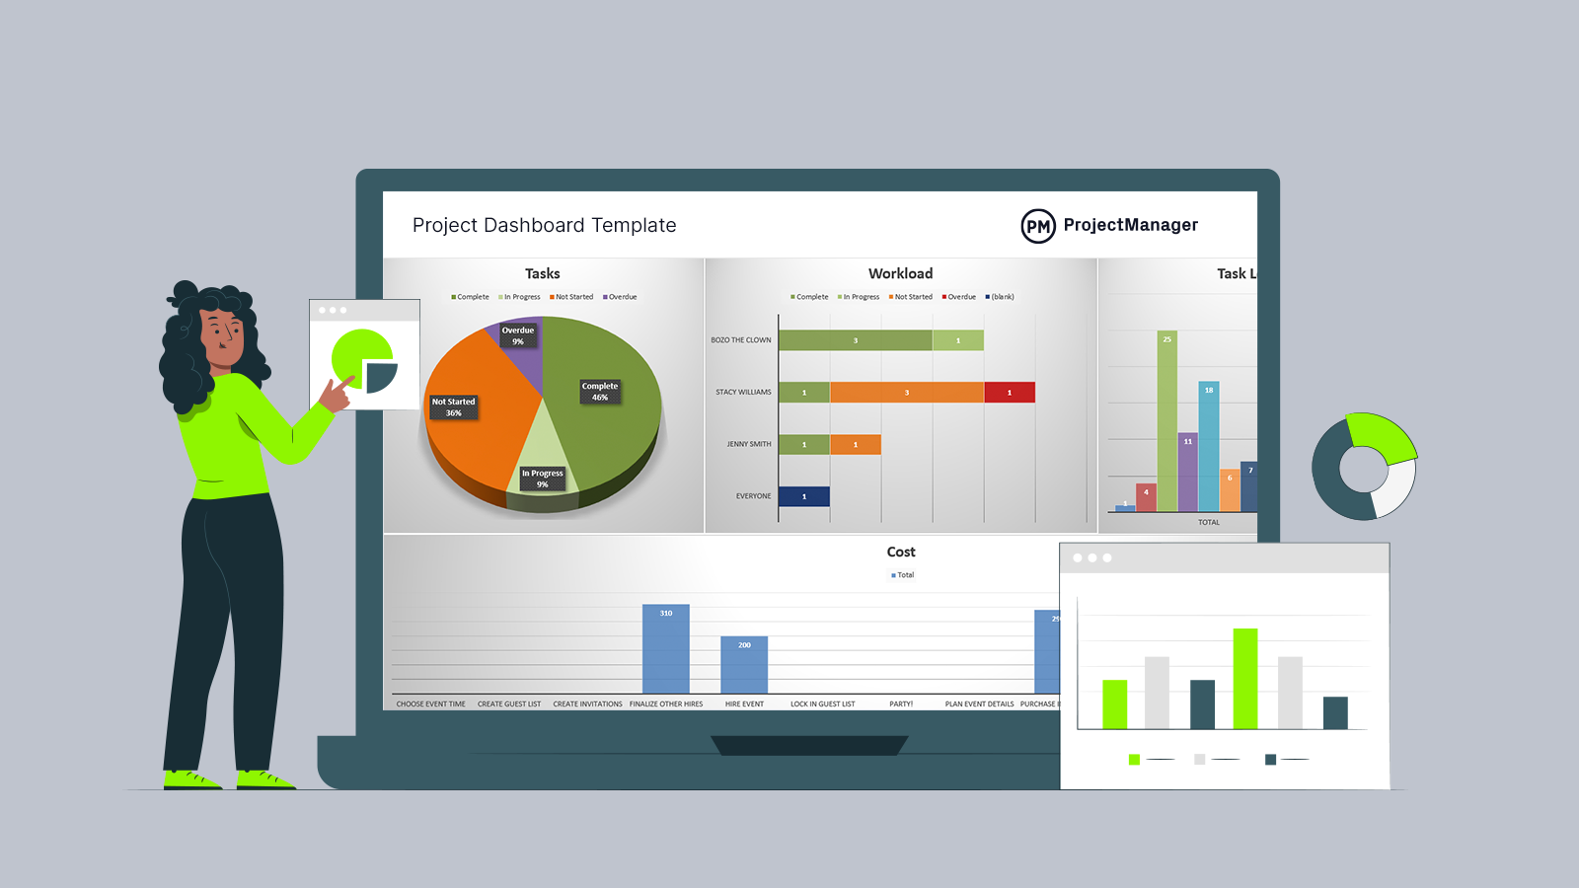
DASHBORD

Slide 16
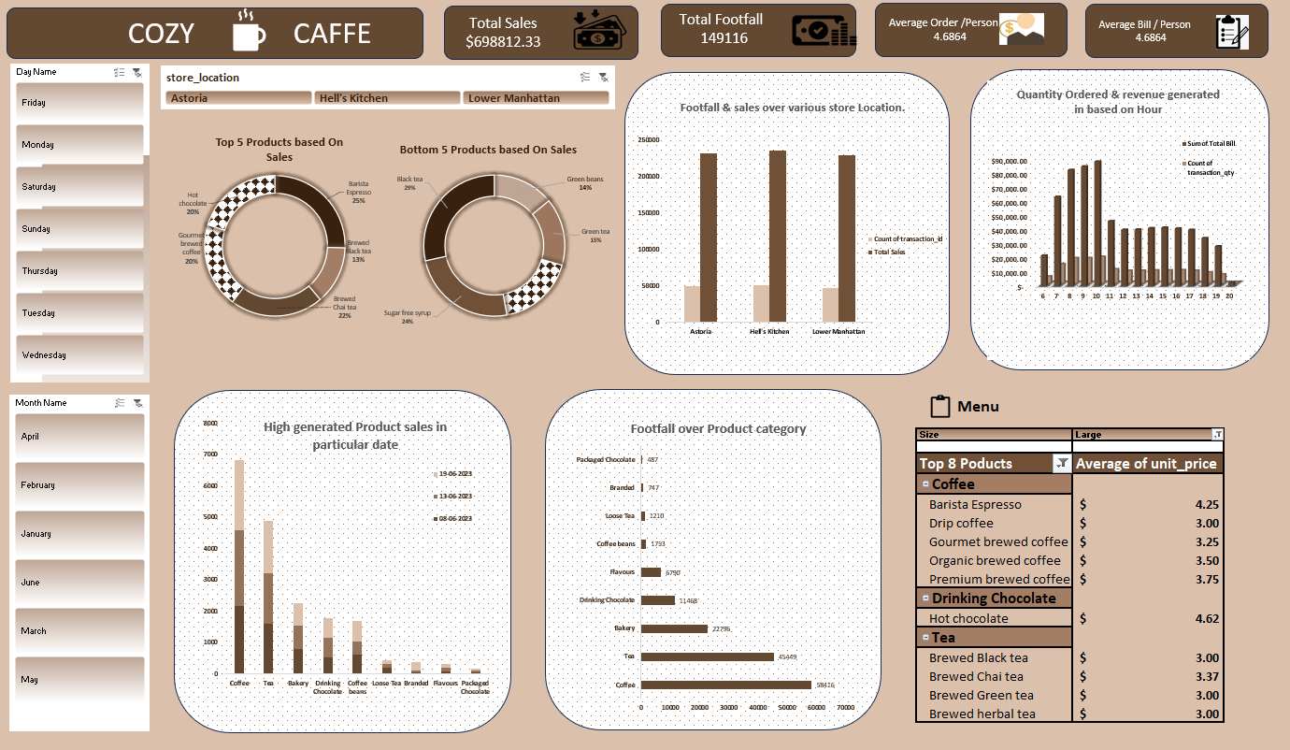

Slide 17


Thank you
COZY
CAFFE
THANK YOU

